Slide 1
Lecture 11 – Access Control Lists (ACL)
COMP1002 (Cybersecurity and Networks)

Slide 2
Objectives
ACL filtering functionality
Standard and extended IPv4 ACLs
Wildcard masks
Creating and placement of ACLs
Configure standard and extended IPv4 ACLs
ACL processing and logic

Slide 3
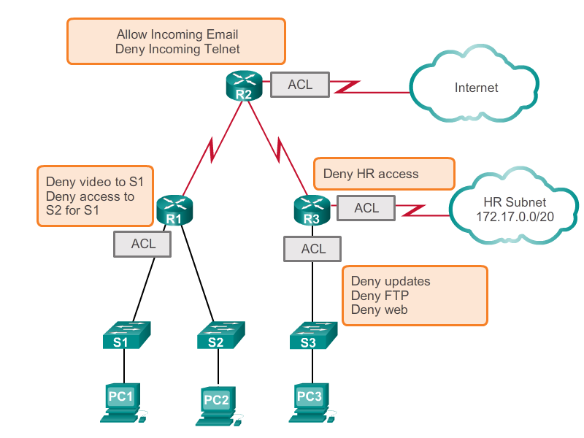
What is an ACL

Slide 4
What is an ACL
ACL - sequential list of permit or deny statements
a.k.a. access control entries (ACEs).
When network traffic passes through an interface configured with an ACL, the router compares the information within the packet against each statement, in sequential order, to determine if the packet matches one of the ACLs.
IPv4 ACLs include the use of wildcard masks.

Slide 5
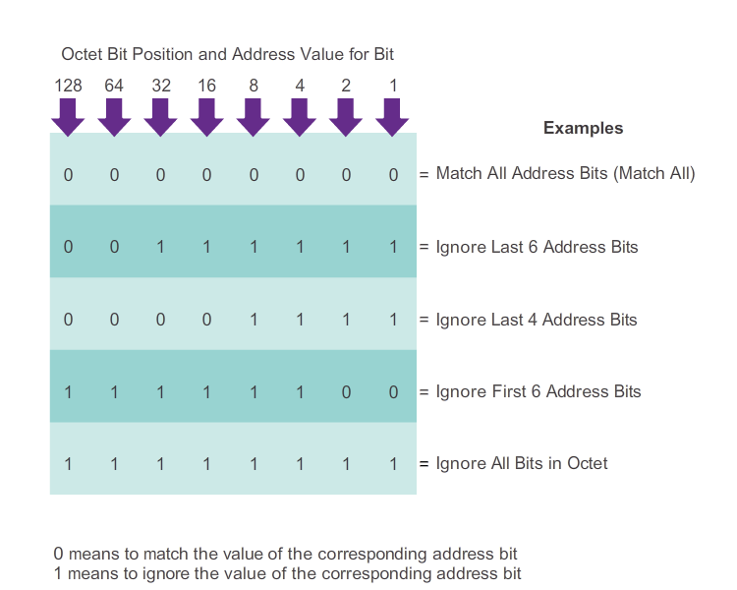
Wildcard masks

Slide 6
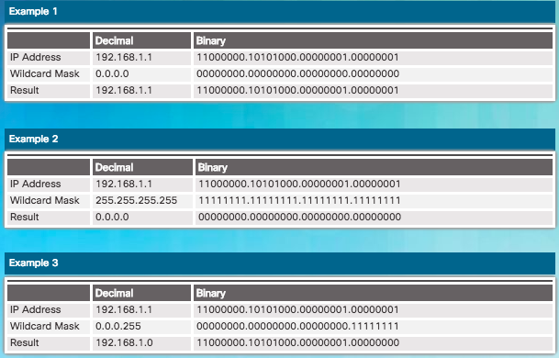
Wildcard masks

Slide 7
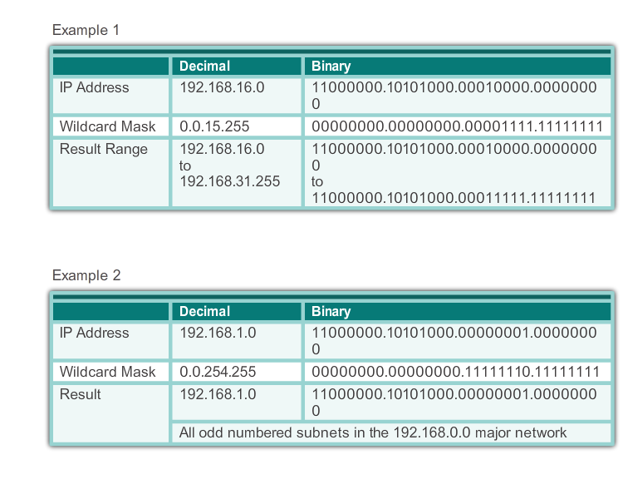
Wildcards for ranges

Slide 8
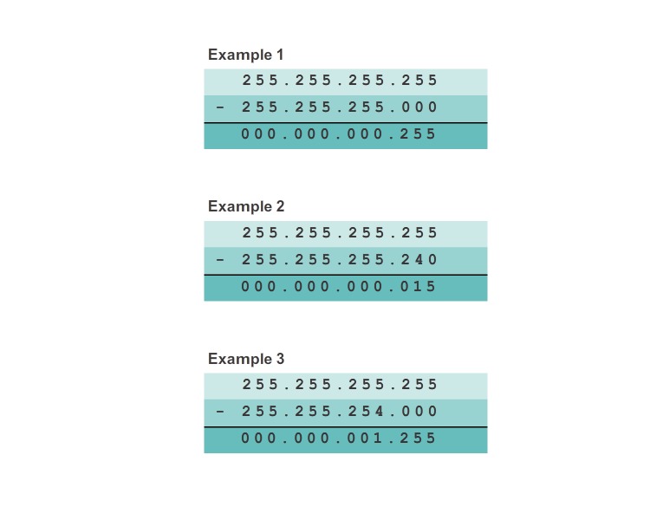
Wildcard mask calculation

Slide 9
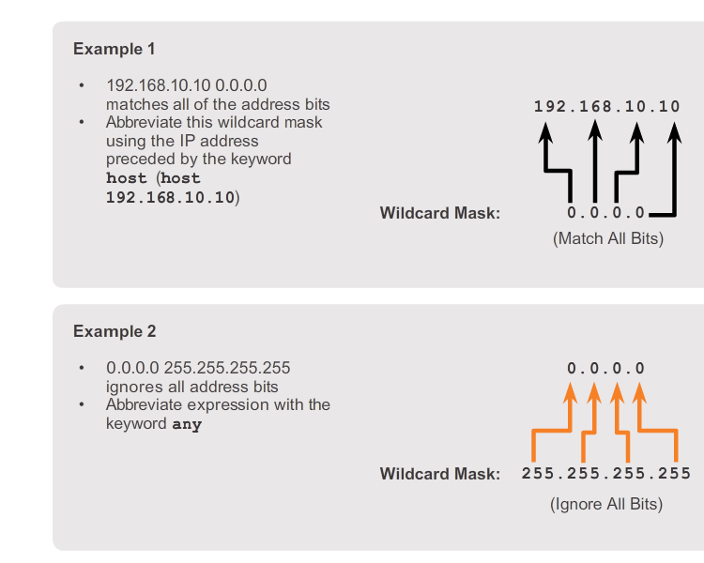
Wildcard abbreviations

Slide 10
Inbound and Outbound ACLs
Inbound ACLs - Incoming packets are processed before they are routed to the outbound interface.
efficient because it saves the overhead of routing lookups if the packet is discarded.
If the packet is permitted by the tests, it is then processed for routing.
best used to filter packets when the network attached to an inbound interface is the only source of the packets needed to be examined.
Outbound ACLs - Incoming packets are routed to the outbound interface, and then they are processed through the outbound ACL.
best used when the same filter will be applied to packets coming from multiple inbound interfaces before exiting the same outbound interface.

Slide 11
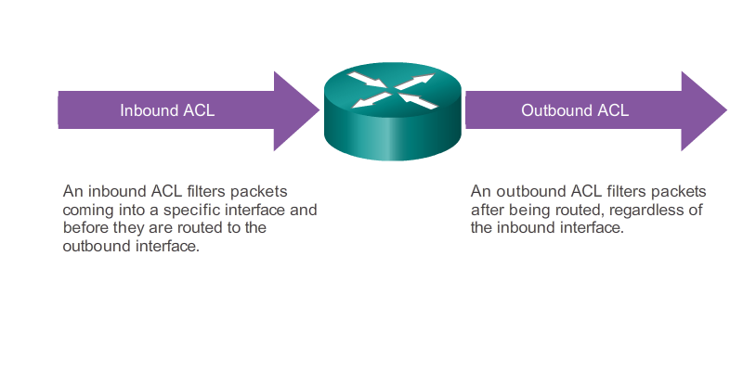
Inbound and Outbound ACLs

Slide 12

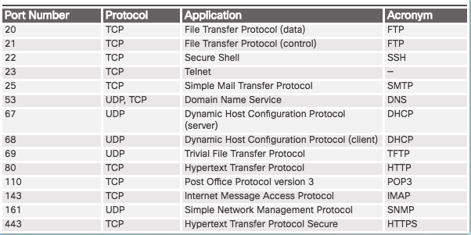
TCP/UDP ports

Slide 13
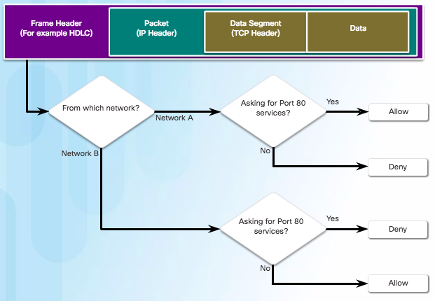
ACL packet filtering

Slide 14
Deny all
ACLs are processed sequentially, until a match is identified
The last statement of an ACL is always an implicit deny, blocking all traffic that reaches it
automatically inserted at the end of each ACL even though it is not physically present
an ACL that does not have at least one permit statement will block all traffic.
used to permit or deny traffic only from source IPv4 addresses. The destination of the packet and the ports involved are not evaluated.

Slide 15
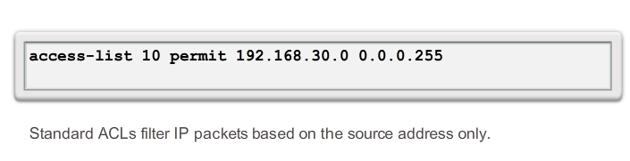
Standard ACLs

Slide 16
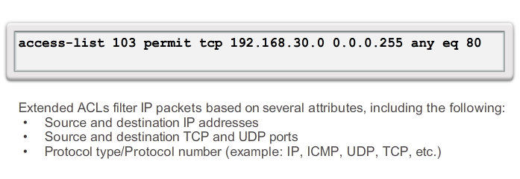
Extended ACLs
Multiple attributes may be used as filter
ACL 103 permits traffic originating from any address on the 192.168.30.0/24 network to any IPv4 network if the destination host port is 80 (HTTP).

Slide 17
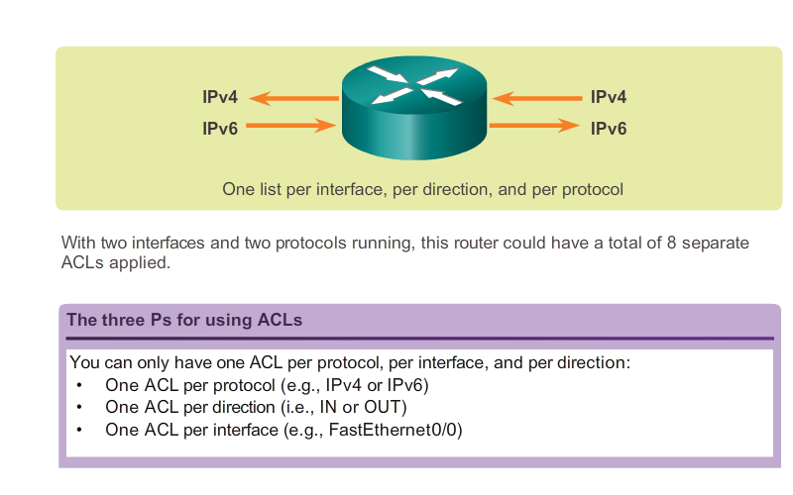
ACL traffic filtering

Slide 18
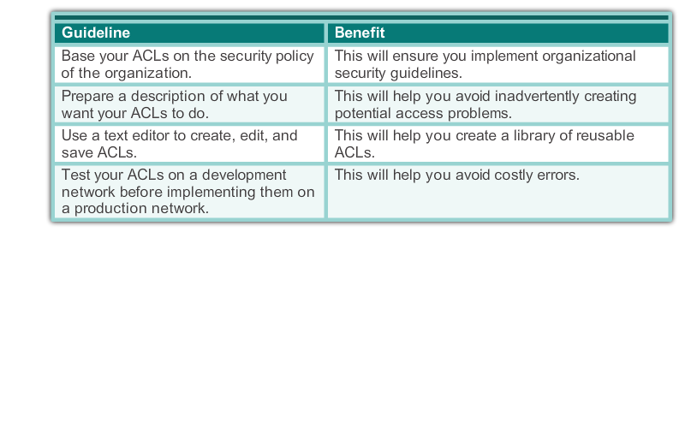
ACL best practices

Slide 19
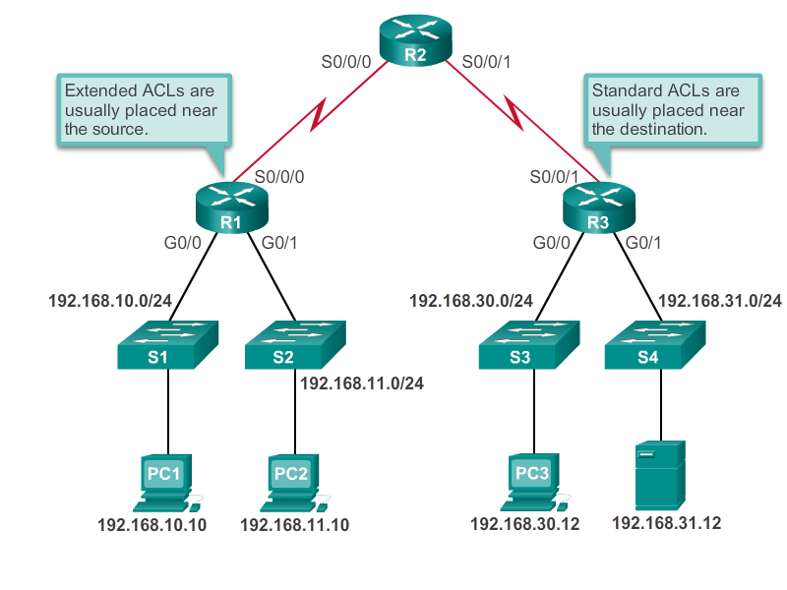
Where to place ACLs

Slide 20
Where to place ACLs
Extended ACLs - close to the source of the traffic to be filtered.
undesirable traffic is denied close to the source network without crossing the network infrastructure.
Standard ACLs – close to the destination of the traffic to be filtered
Standard ACLs do not specify destination addresses
Placing a standard ACL at the source of the traffic will effectively prevent that traffic from reaching any other networks through the interface where the ACL is applied.
SEDS - Source Extended / Destination Standard

Slide 21
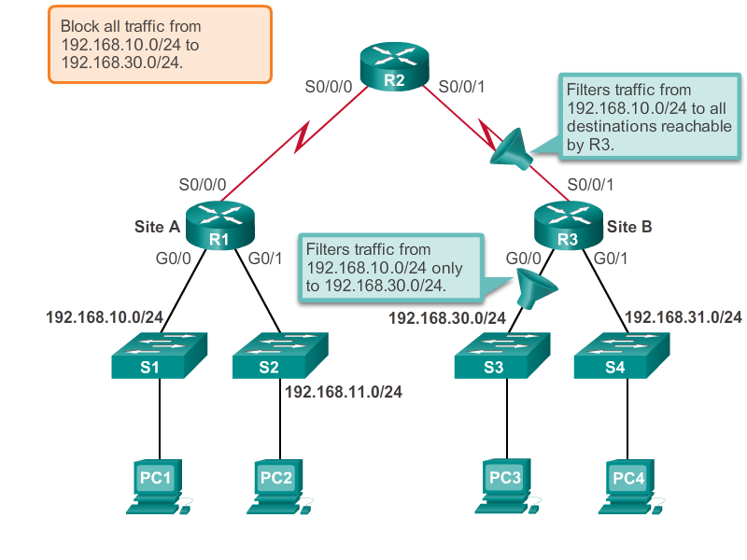
Standard ACL placement

Slide 22
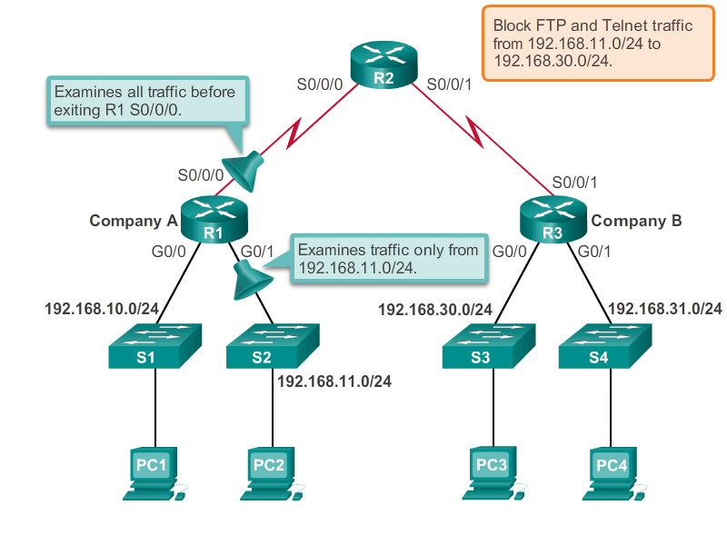
Extended ACL placement

Slide 23
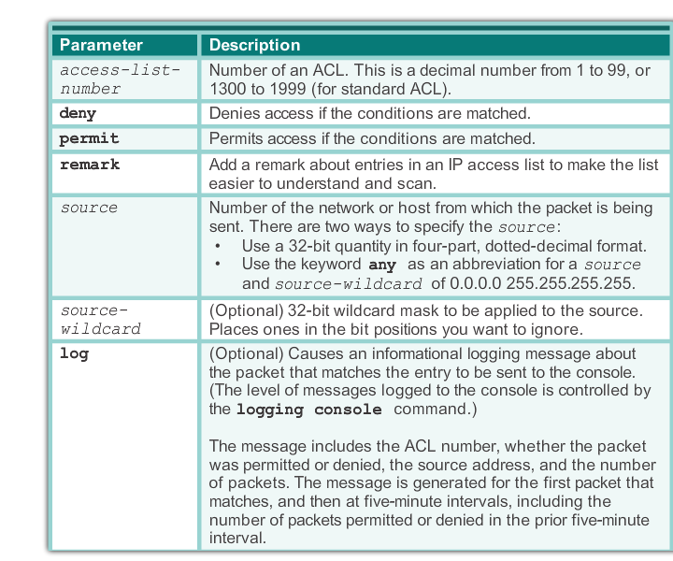
ACLs – configuration
Router(config)# access-list access-list-number { deny | permit | remark } source [ source-wildcard ][ log ]

Slide 24
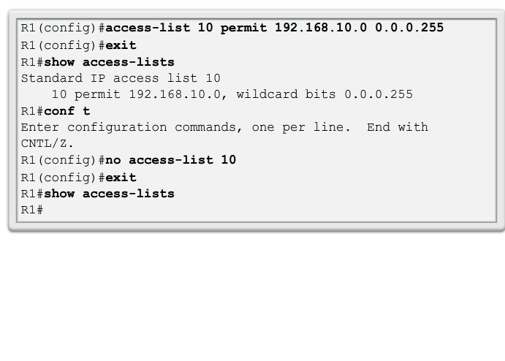
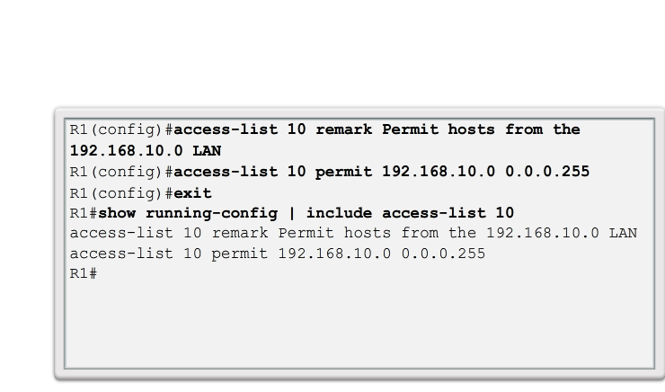
Add/remove ACLs

Slide 25
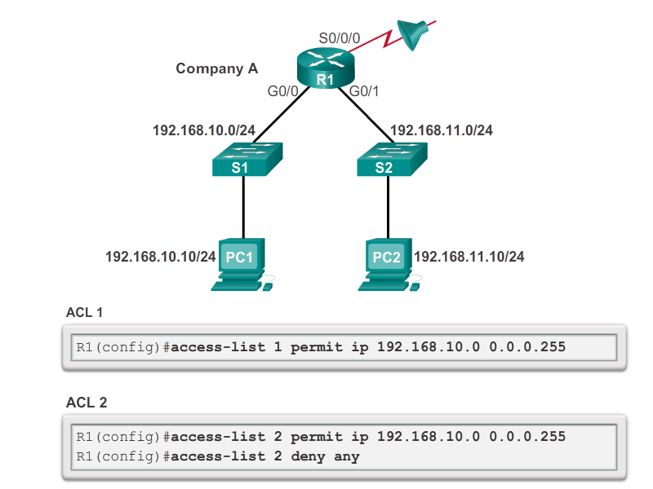
ACLs - statements

Slide 26
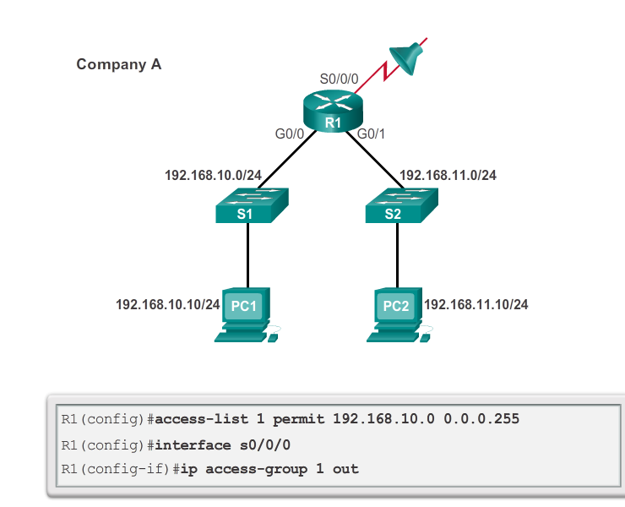
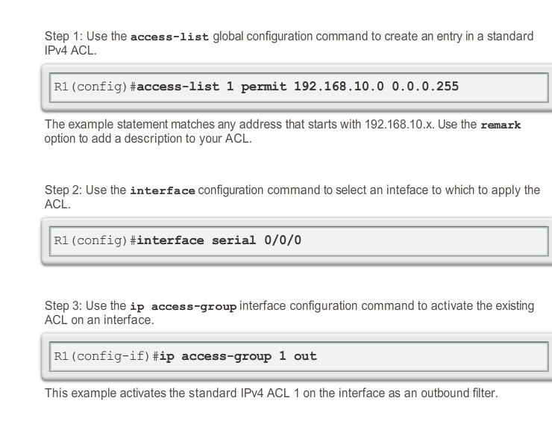
Apply ACL to interface

Slide 27
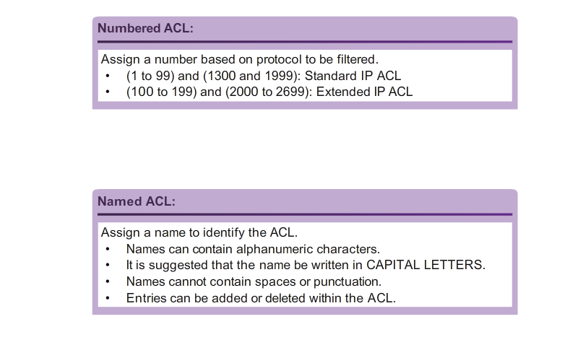
Numbered/named ACLs

Slide 28
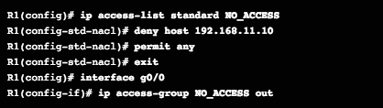
Named ACLs

Slide 29
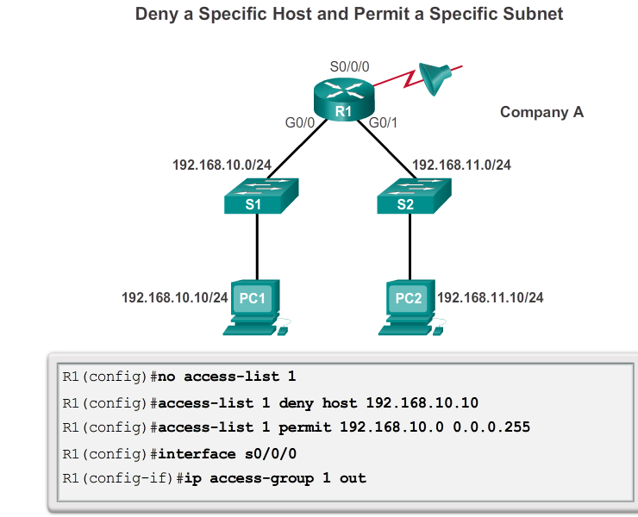
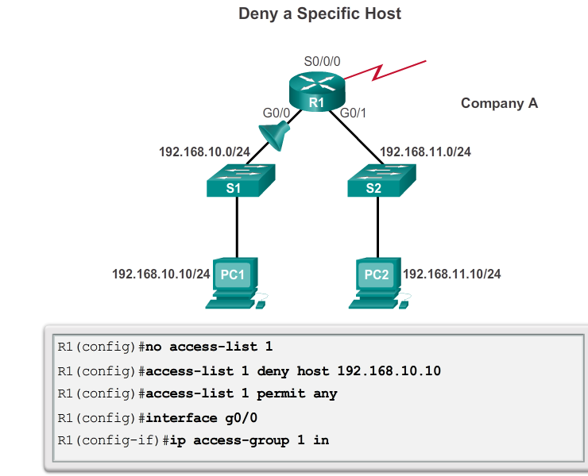
ACL examples

Slide 30
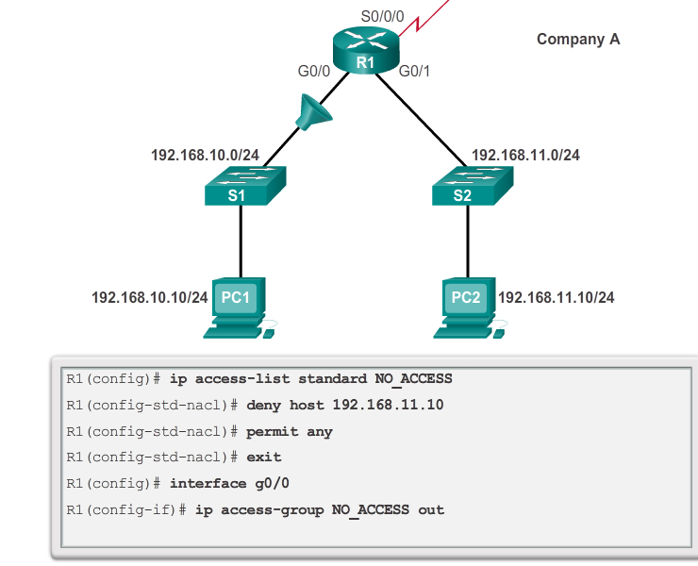
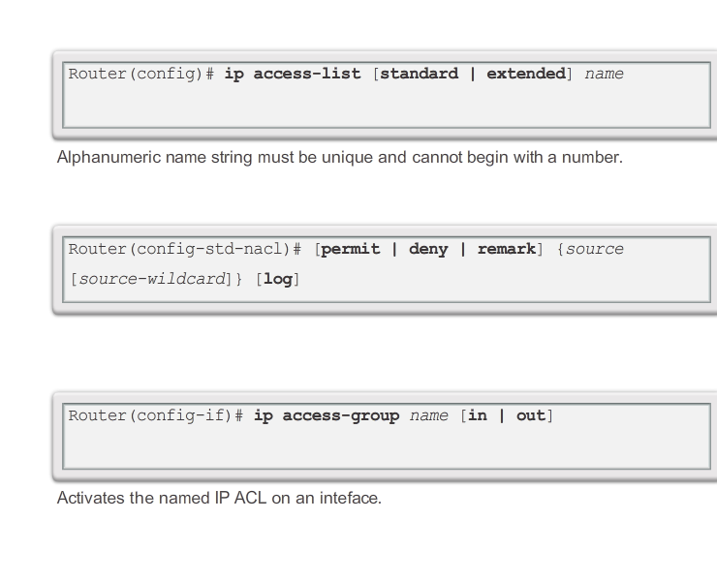
Named ACL example

Slide 31
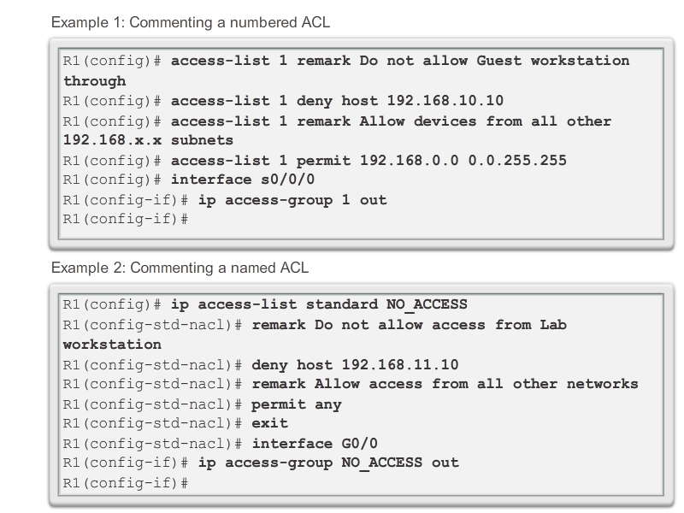
Commenting ACLs

Slide 32
Editing ACLs
Text editor or using sequence numbers
Recommended – text editor
Easier to follow logic/make changes
Remove and reapply when ready

Slide 33
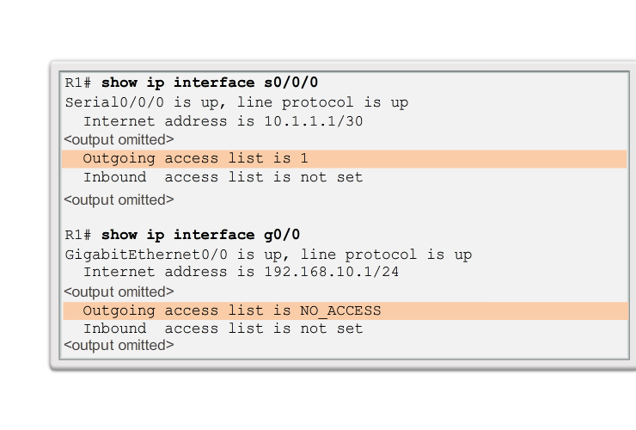
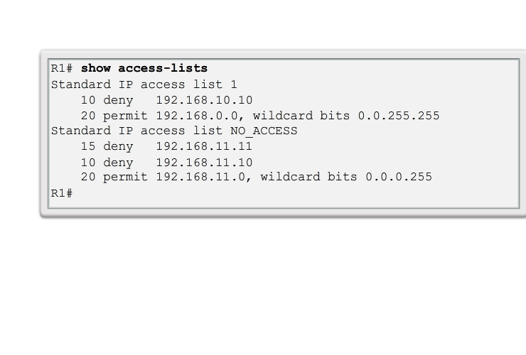
Verify ACLs

Slide 34
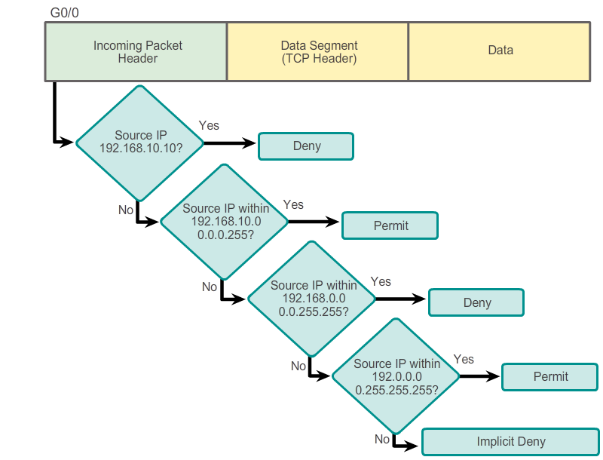
ACLs – logic
access-list 2 deny 192.168.10.10
access-list 2 permit 192.168.10.0 0.0.0.255
access-list 2 deny 192.168.0.0 0.0.255.255
access-list 2 permit 192.0.0.0 0.255.255.255

Slide 35
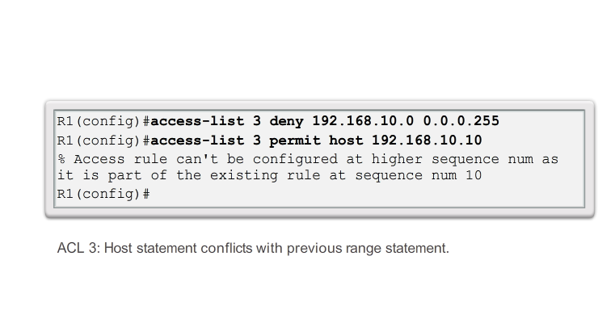
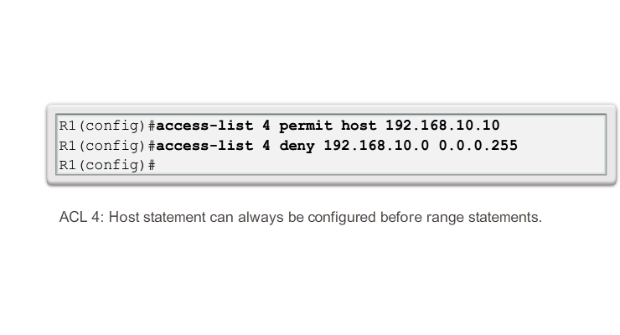
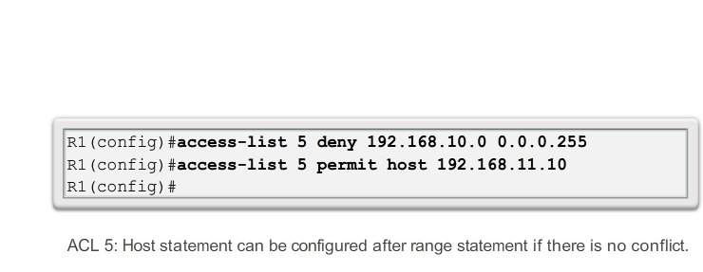
Logic conflicts

Slide 36
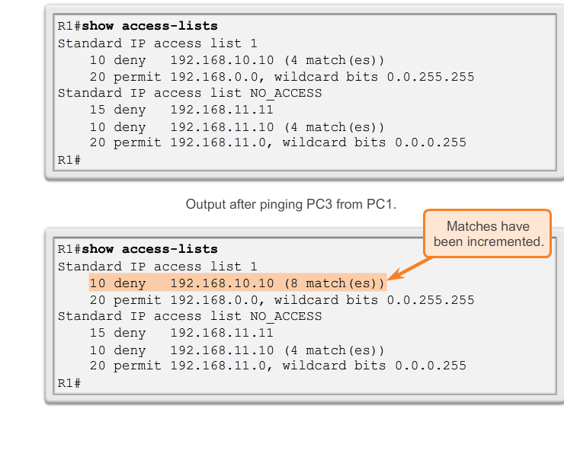
ACL statistics

Slide 37
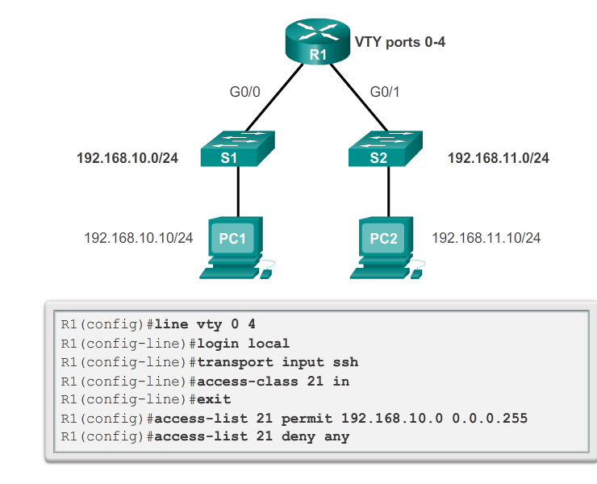
Secure VTY ports with ACLs

Slide 38
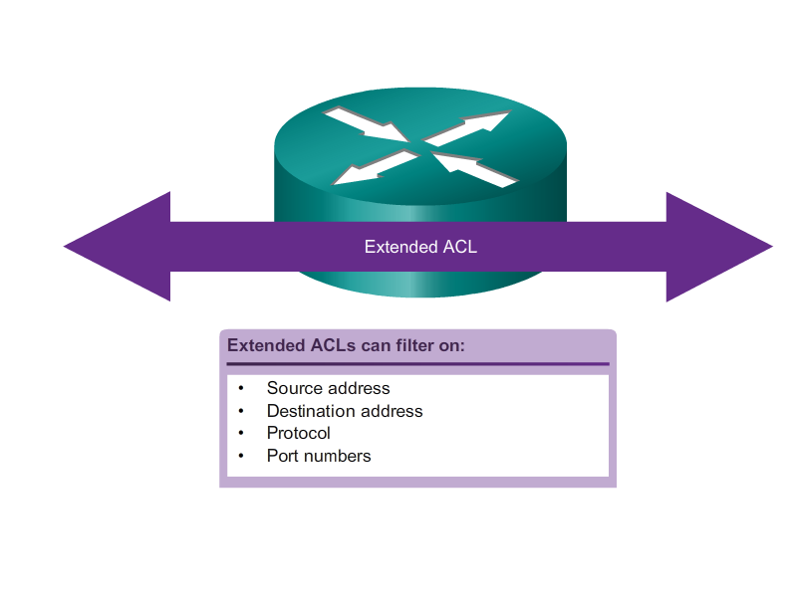
Extended ACLs

Slide 39
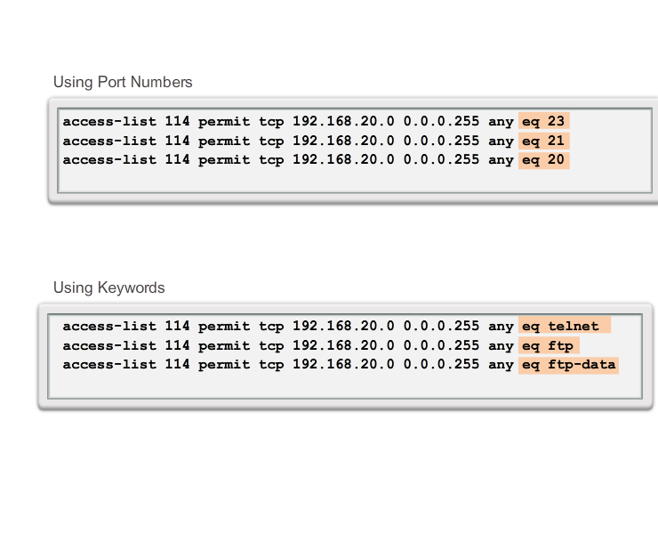
Extended ACLs

Slide 40
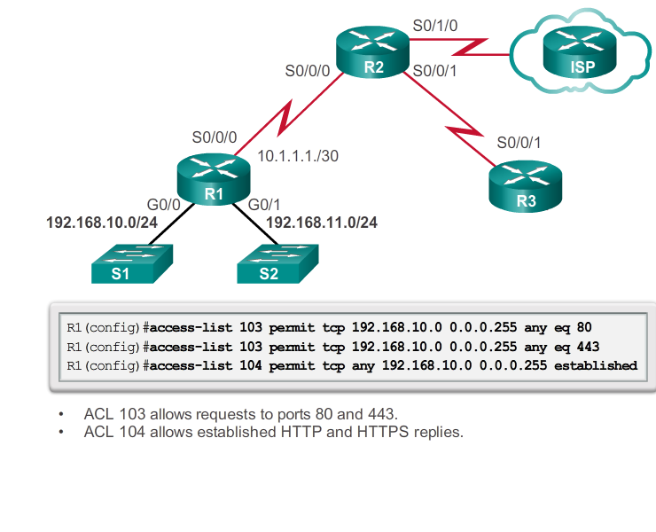
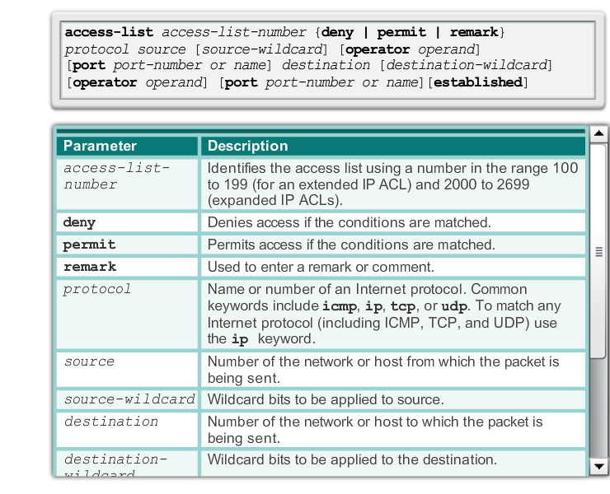
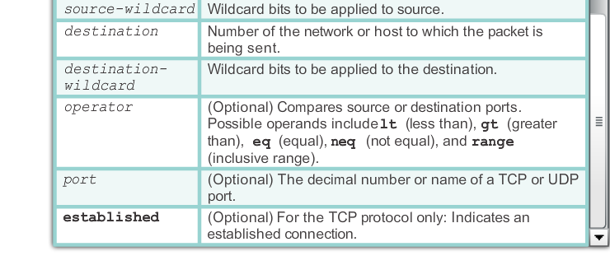
Configure extended ACLs

Slide 41
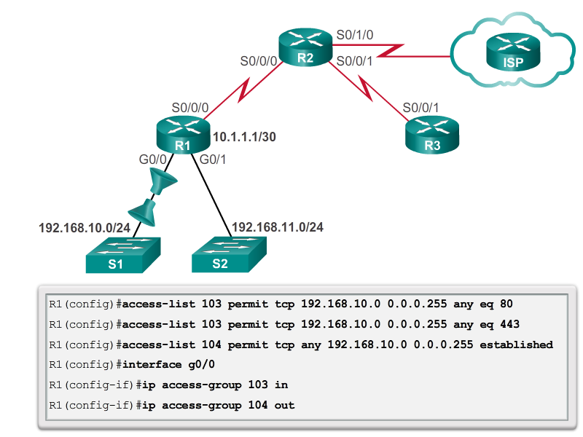
Apply extended ACL to interface

Slide 42
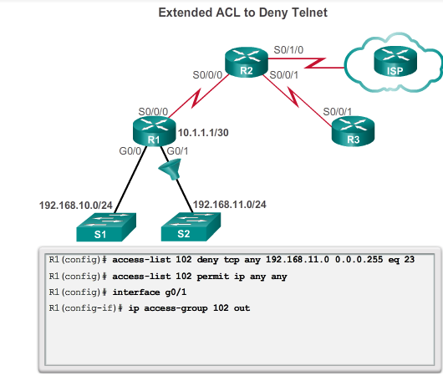
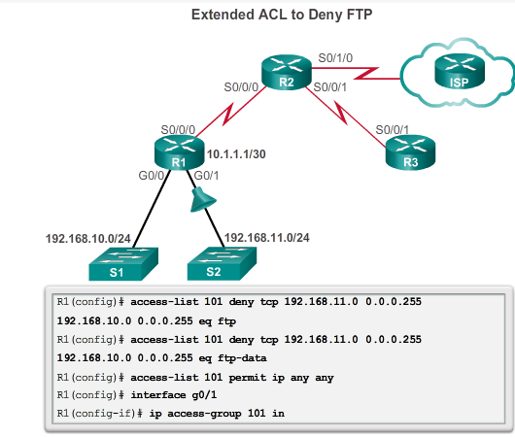
Extended ACL examples

Slide 43
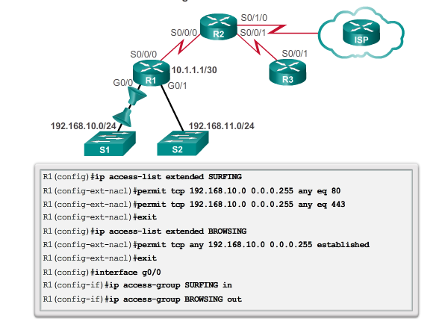
Named extended ACLs

Slide 44
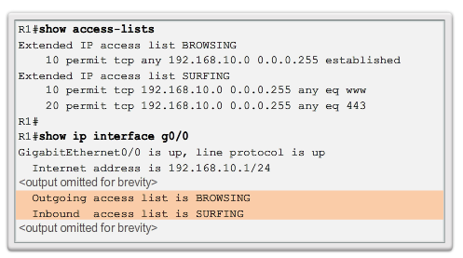
Verify extended ACLs

Slide 45
Activities and labs
4.1.3.5 Packet Tracer - Configure Standard IPv4 ACLs
4.2.2.10 Packet Tracer - Configuring Extended ACLs - Scenario 1
4.2.2.11 Packet Tracer - Configuring Extended ACLs - Scenario 2
4.2.2.12 Packet Tracer - Configuring Extended ACLs - Scenario 3

